Slide 1







Slide 2


Team Name : The Munchkins
Domain : HealthCare Tech & Wellness
PSID:SH-401
Team Details
Role | Name | Phone Number | Roll Number
Team Lead | G. AGASTHYA | 7794913751 | 25R21A05BH
Team Member 1 | K.SAI RUTHVIK REDDY | 9100605066 | 25R21A0589
Team Member 2 | N.Nithya | 9853014462 | 25R21A6644
Team Member 3 | T. Rithwik Chendra | 8309625499 | 25R21A67B3

Slide 3

Problem Statement & Understanding
LONGITUDINAL ADVERSE DRUG INTERACTION PREDICTOR
Current systems focus mainly on pairwise drug interactions. But real-world adverse reactions can result from multiple medications interacting over time.
Key Challenges:
• Changing Regimens — Drugs are started, stopped, or dose-adjusted.
• Temporal Effects — Symptoms may appear during or after medication changes.
• Multi-Drug Overlap — Several medications may act simultaneously.
• Hidden Interactions — Pairwise checks can miss complex multi-drug patterns.
• Patient Context — Timing, dosage, symptoms, and clinical history matter.
• Explainability — Clinicians need to know why a risk was flagged.
Our Understanding:
The problem is fundamentally temporal + multi-drug + patient-specific.
The system therefore needs to connect:
Medication → Time → Dose → Symptoms → Clinical context → Interaction pathway

Slide 4
Proposed Solution & Innovation
LONGITUDINAL
A timeline-first medication intelligence platform that converts a patient’s medication history into an explainable clinical review signal.
How It Works
Patient Data → Data Normalization → Timeline Construction →Medication Overlap Detection → Temporal & Clinical Analysis →
Interaction Signals → Evidence & Risk → Clinical Review Report
Key Innovation
Instead of only asking “Do Drug A and Drug B interact?”, LONGITUDINAL analyzes the complete medication timeline to identify medication overlaps, related symptoms, timing of clinical events, and possible interaction mechanisms.
Major Features
• Medication Timeline – Tracks medication starts, stops, dose changes, and symptoms.
• Temporal Analysis – Links medication changes with nearby clinical events.
• Multi-Drug Intelligence – Evaluates the complete medication stack instead of isolated drug pairs.
• Explainable Risk Signals – Provides temporal, clinical, and mechanistic evidence.
• Clinical Review Reports – Provides structured evidence and risk summaries.

Slide 5
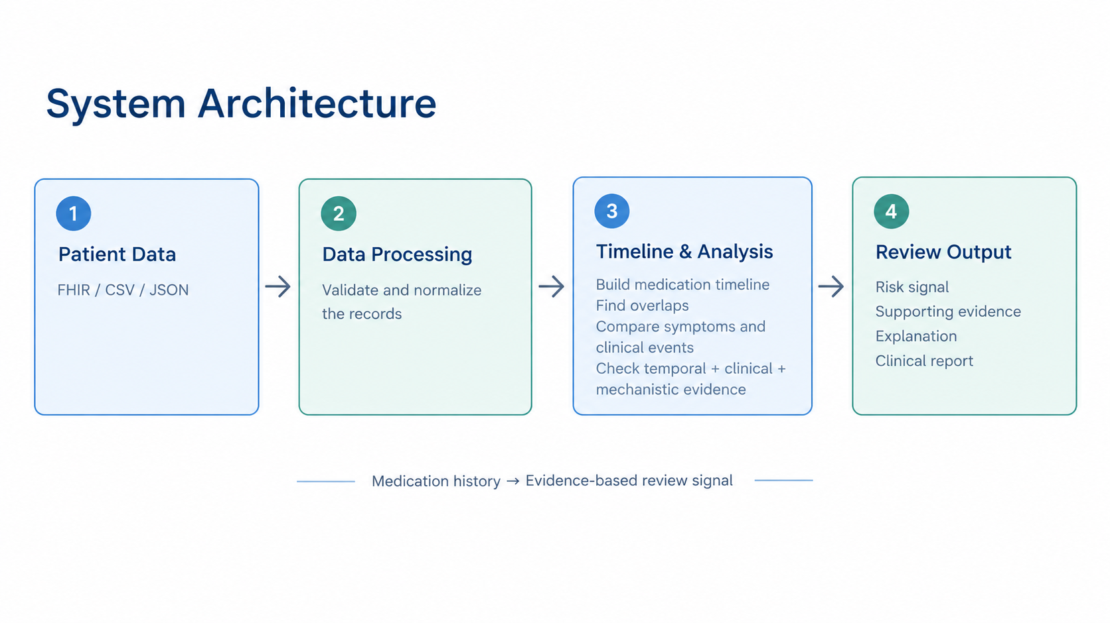
Technical Implementation
Architecture:
1.Synthetic FHIR Data
Patient • MedicationRequest • Condition • Observation
↓
2.Normalization
FHIR Bundle → Patient, Medication, Timeline, Clinical Events
↓
3.Intelligence
Temporal + Mechanistic + Clinical Evidence
↓
4.Output
Risk Level • Confidence• Evidence • Explainable Review
Evidence Analysis:
1.Temporal-Medication changes • Overlap duration • Symptom timing
2.Mechanistic-Pathways • Enzymes • Transporters • Shared mechanisms
3.Clinical-Symptoms • Severity • Lab observations • Existing conditions
4.Technology Stack-Frontend: React • TypeScript • Vite • TanStack Router • Tailwind CSS
5.Visualization-Recharts • Interactive Timelines • Knowledge Graph • Three.js

Slide 6
Impact & Feasibility
Impact
• Patient-specific longitudinal medication view
• Highlights symptoms around medication changes
• Detects potential multi-drug patterns
• Provides evidence for each review signal
• Supports explainable, non-black-box clinical review
Feasibility
The working prototype demonstrates:
Data Import → Normalization → Timeline →
Interaction Analysis → Risk Signal → Explanation → Report
• Supports CSV, JSON, and conceptual FHIR-style input
• Includes data validation and normalization
Scalability
• Larger synthetic cohorts
• Drug knowledge bases and literature integration
• Clinician feedback and labeled-data evaluation
Safety Boundary
The system generates an explainable review signal. It does not provide
a confirmed diagnosis or establish causality.

Slide 7
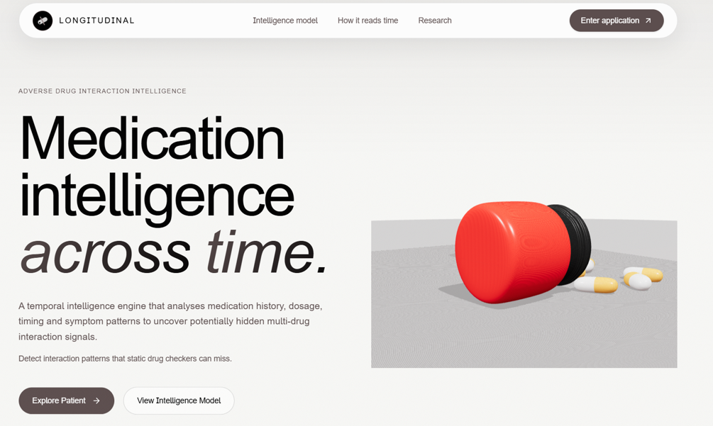
References & Research
1. HL7 FHIR Specification
Standard for healthcare interoperability and
structured clinical data exchange.
2. Synthea – Synthetic Patient Population Simulator
Generates realistic, fictional longitudinal patient
records in FHIR format.
3. Synthea Research Publication
Research on synthetic electronic health records and longitudinal patient modeling.
4. HL7 FHIR Resource Documentation
Documentation for Patient, MedicationRequest, Condition, Observation, and related resources.
5. LONGITUDINAL Prototype
longitudinaldrug.vercel.app

